Slide 1
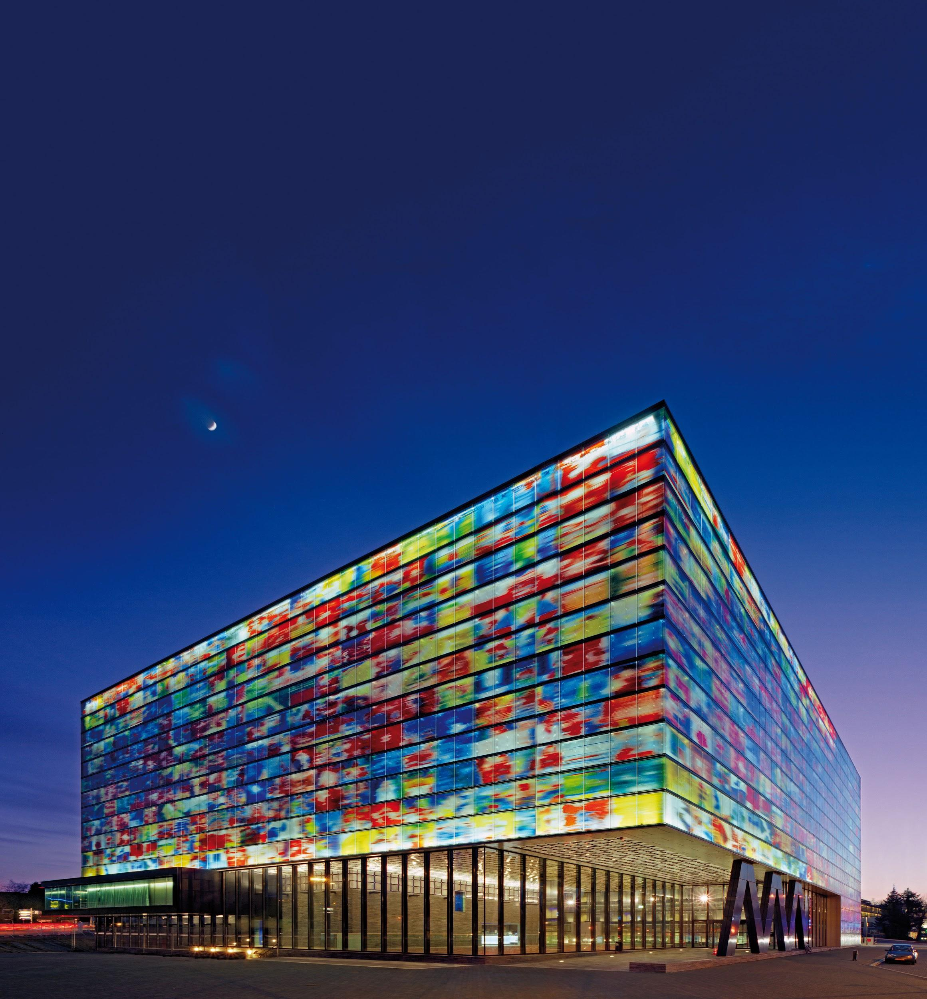
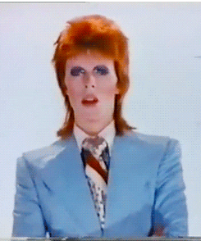
#NTTW5
Welcome to the
Netherlands Institute for Sound and Vision
Notes:
From the The Digital Universe Decade – Are You Ready? Report (2010):
“Between [2010] and 2020, the amount of digital information created and replicated in the world will grow to an almost inconceivable 35 trillion gigabytes as all major forms of media – voice, TV, radio, print – complete the journey from analog to digital.”

Slide 2
#NTTW5 Dates
September 23 - workshops (Wednesday)
September 24-25 - single stream conference (Thursday-Friday)
...only 292 days away! 😅 😅 😅
Notes:
Productmanager
Doen dat met alle afdelingen

Slide 3
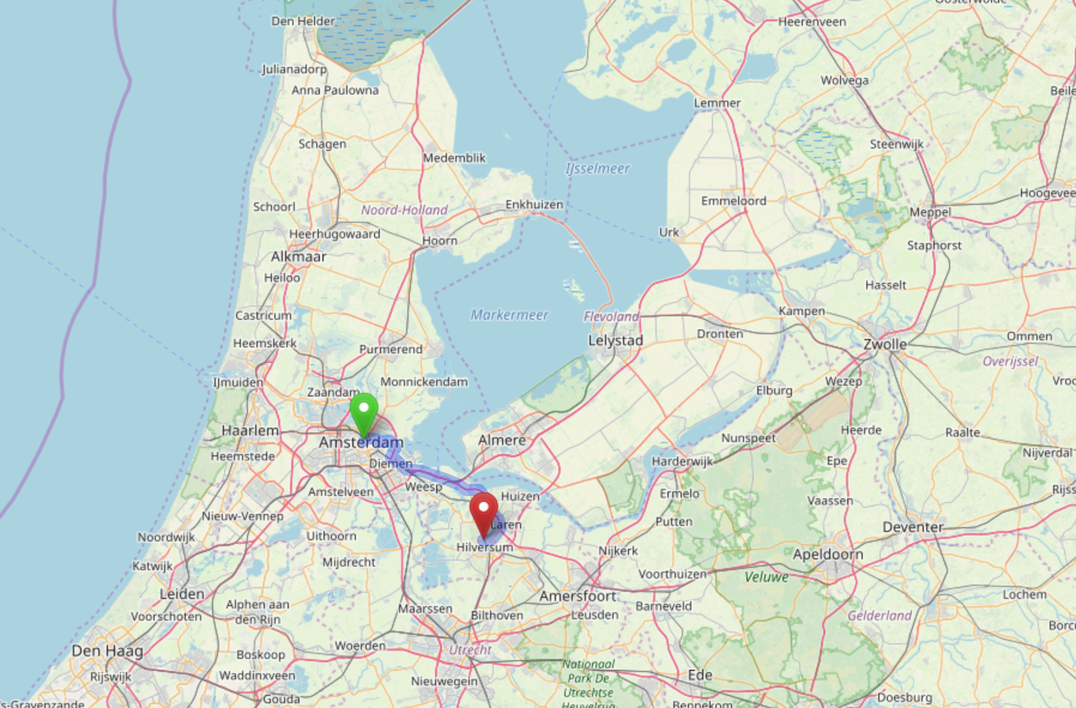
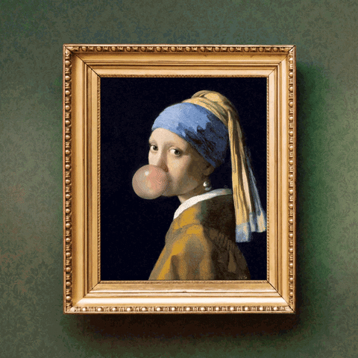
30 minutes 🚆 from Amsterdam
45 minutes 🚆 from Schiphol Airport
90 minutes 🚆 to the Mauritshuis

Slide 4
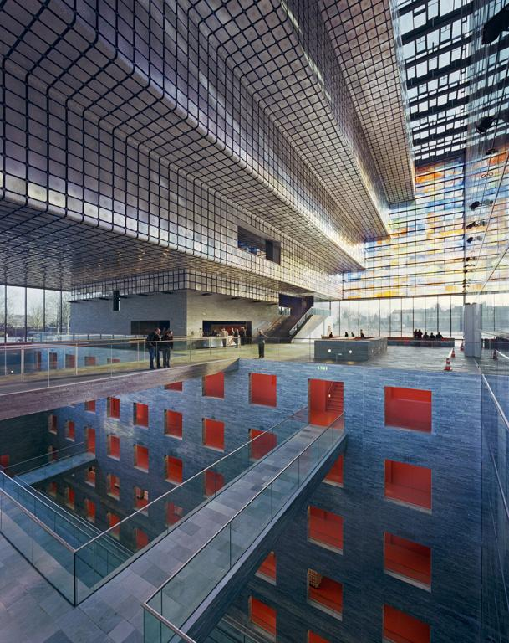
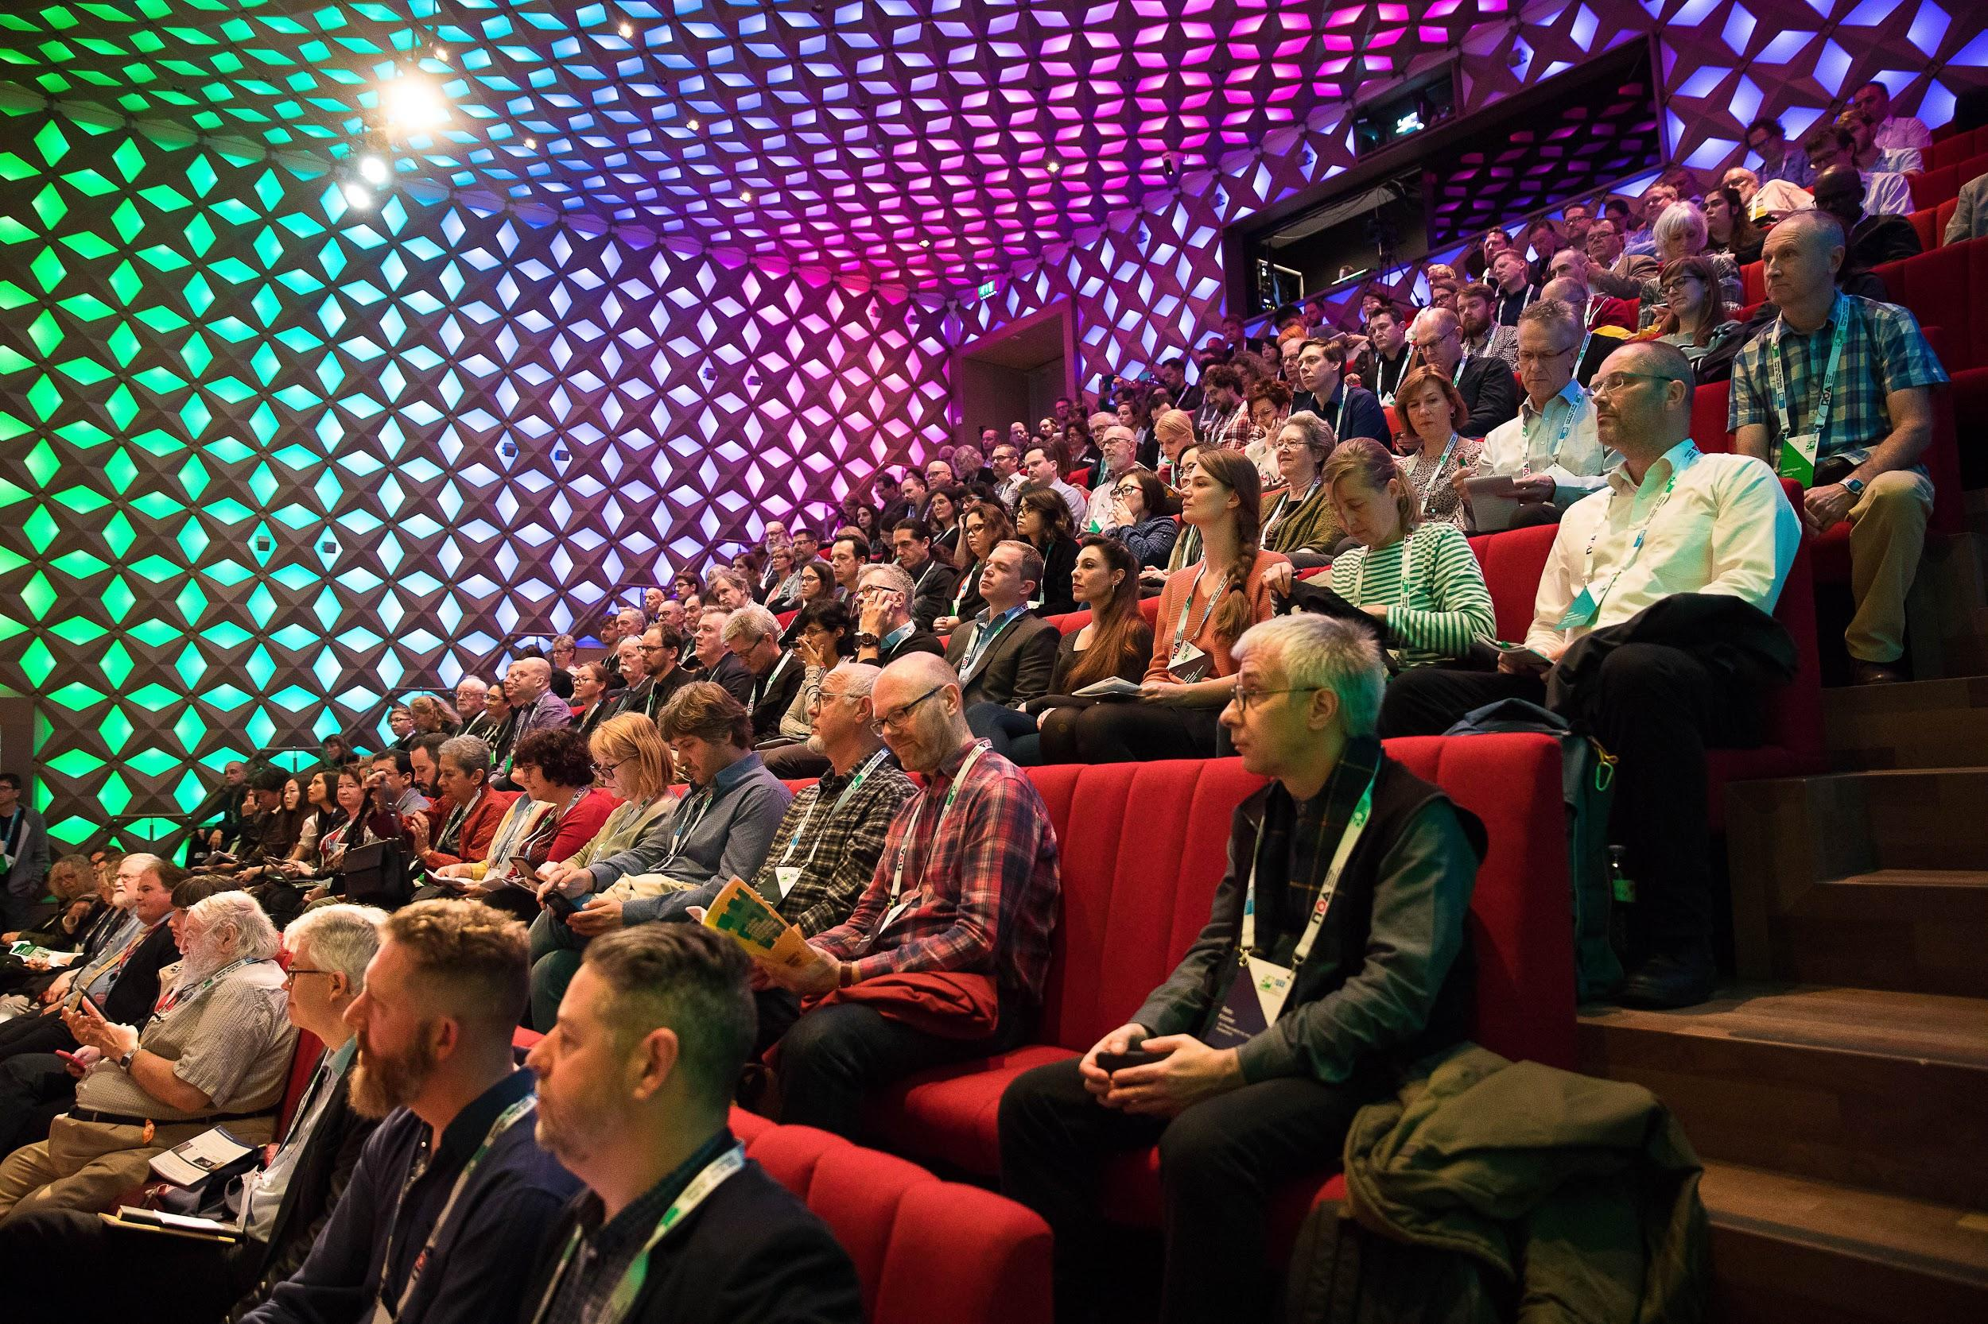
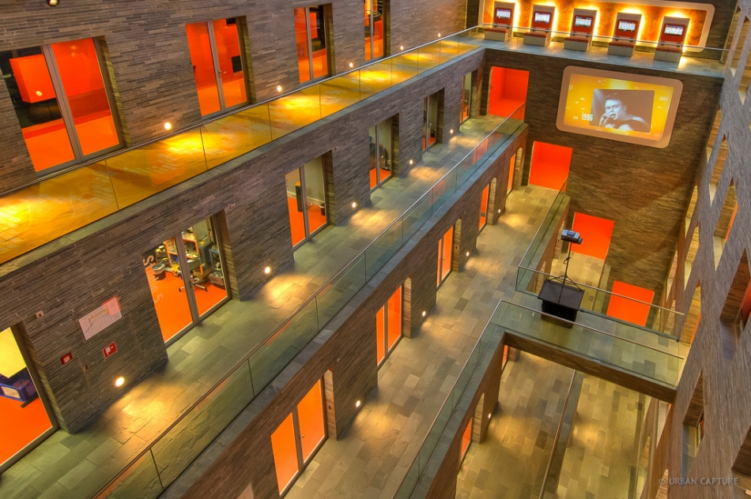

Slide 5
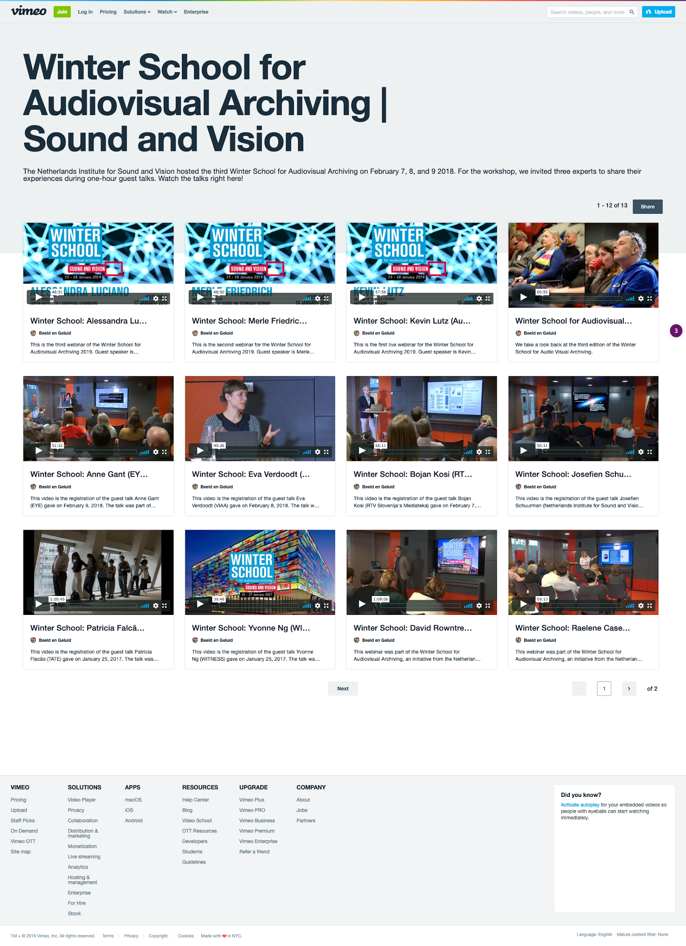
Notes:
Involvement with FFv1 / MKV: initial impulse through PREFORMA
We wanted MXF but the CELLAR people said no, no, no
Involvement with shared infrastructure through NDE
Included organising iPres last year
Sharing knowledge locally through AVA_Net activities
Livestreaming: every year at the Winter School (=> various open source project talks!)
Open source at Sound and Vision…. ? => WE NEED YOUR HELP 😬

Slide 6
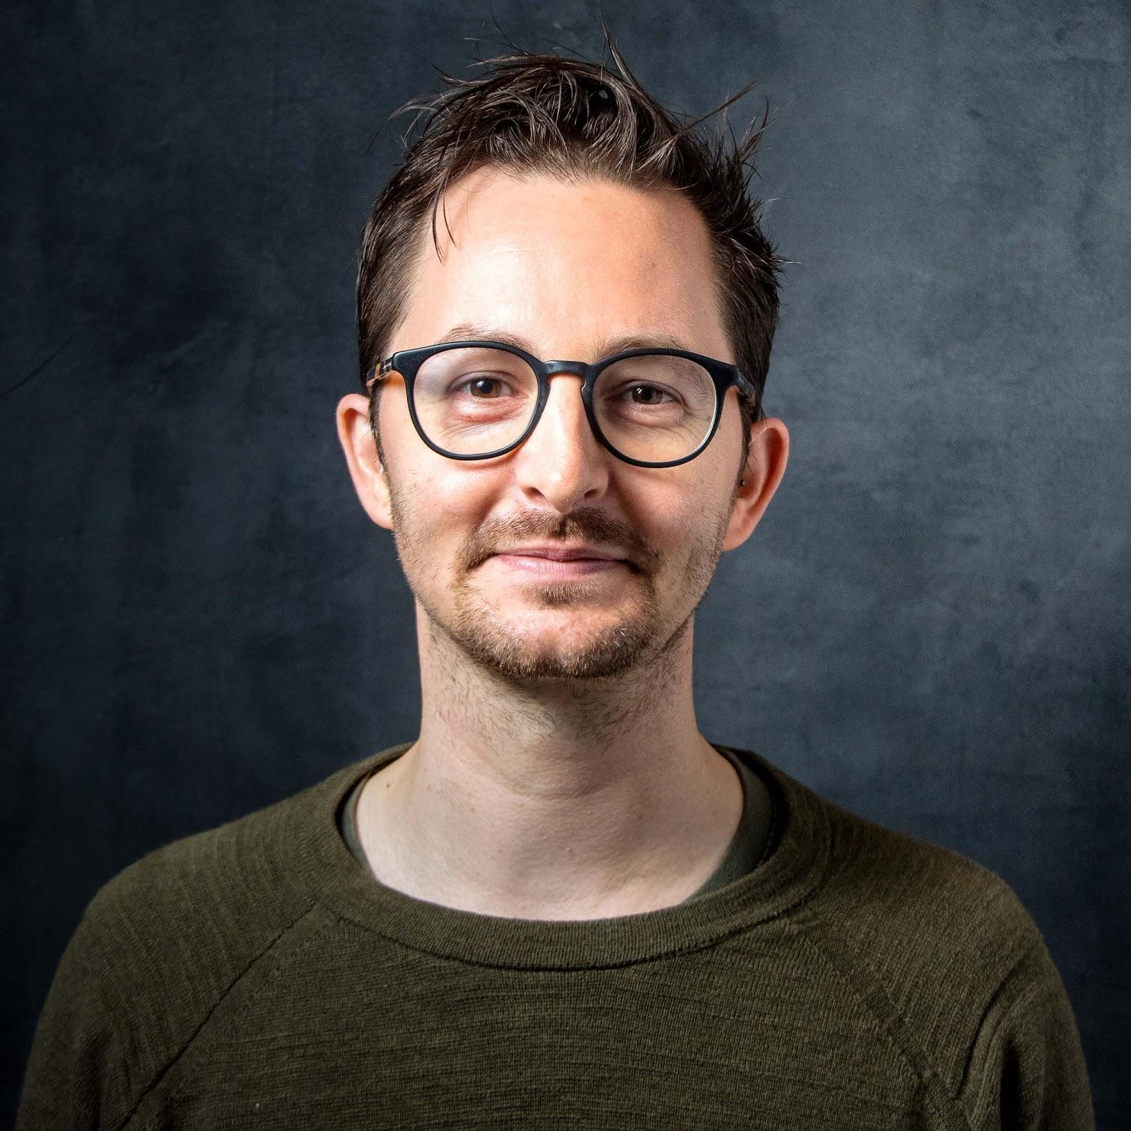
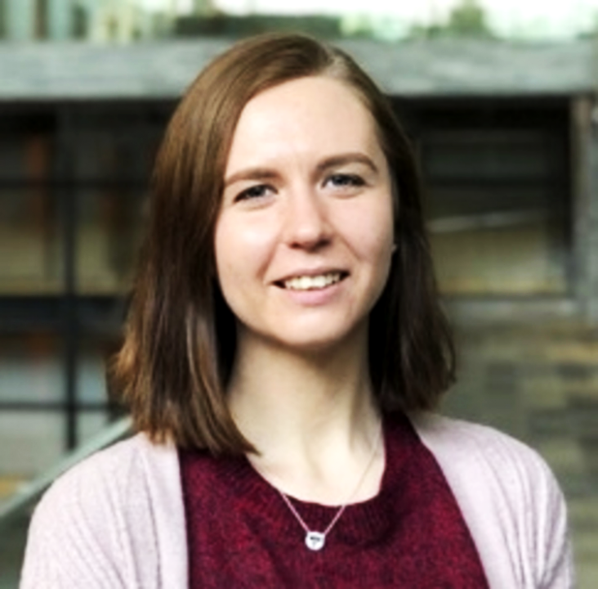
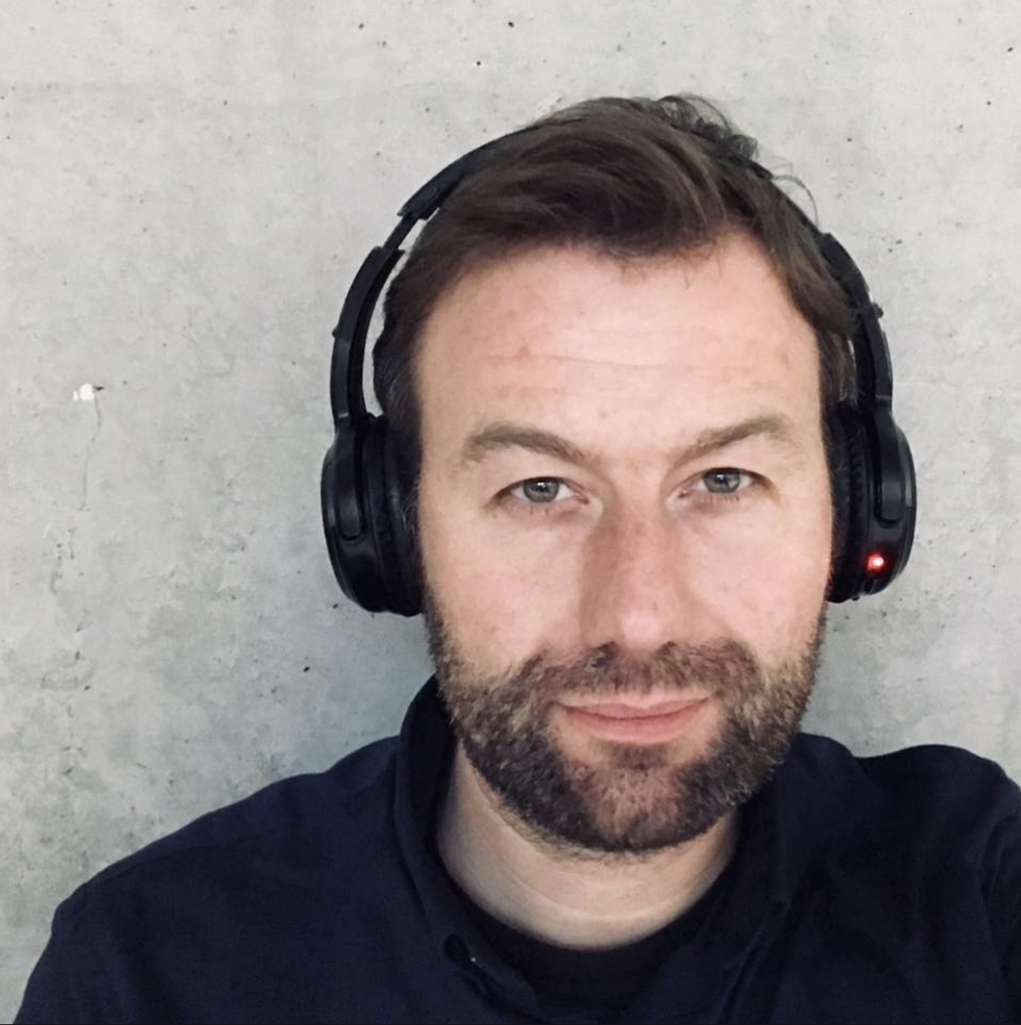
YOUR LOCAL ORGANISERS
Erwin Verbruggen
Rasa Bočytė
Johan Oomen
Find us on:
labs.beeldengeluid.nl
twitter: @benglabs
👑

Slide 7
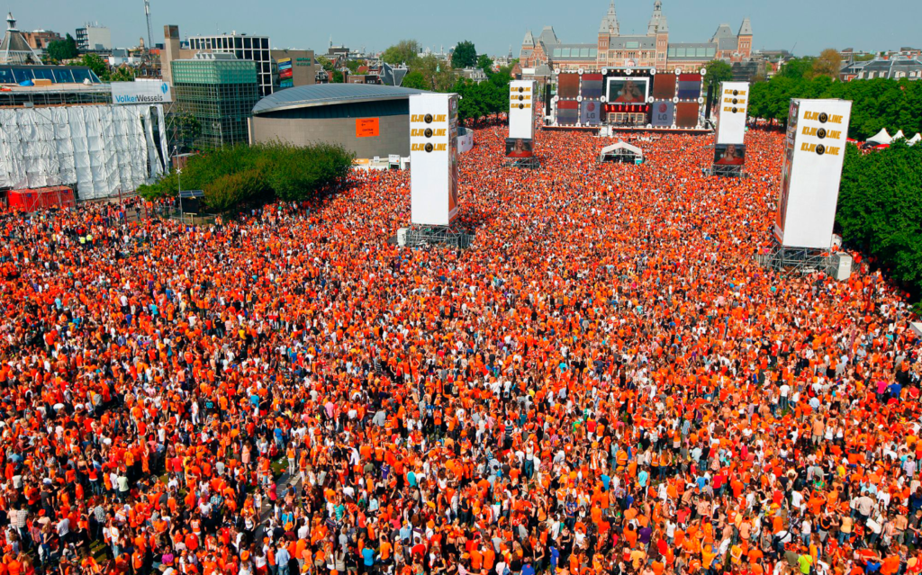
...see you next year in the Netherlands!!!
(September 23-25 2020)

